Slide 1
Student Management System
Adam Adamczyk
IUSB
3/11/2025

Slide 2
Problem Statement
Managing student information in schools can be chaotic.
Many schools use outdated methods like spreadsheets or paper records.
These methods lead to inefficiencies and errors.
This project aims to create a simple and user-friendly Student Management System.

Slide 3
Objectives of the System
Streamline student data management.
Provide an intuitive interface for teachers and staff.
Reduce errors in student records through automation.
Ensure data security and accessibility.

Slide 4
System Features
Student Profiles: Add, edit, delete student records.
Attendance Management: Record and track attendance.
Grade Management: Store and update student grades.
Report Generation: Generate performance reports.
Secure Database Storage: Store data securely in MySQL.

Slide 5
Target Users
School Administrators: Oversee data, generate reports.
Teachers: Update grades and attendance.
(Optional) Parents/Students: View student performance.

Slide 6
Technical Overview
Front-End: HTML, CSS
Back-End: Python (Django framework)
Database: MySQL
Hosting: Local SQL datbace on Mac OS

Slide 7
Development Timeline
Weeks 1-2: Design system structure, set up database.
Weeks 3-4: Implement login and user authentication.
Weeks 5-7: Develop student profile and data management features.
Week 8: Testing phase.
Weeks 9-11: Implement optional features.
Weeks 12-14: Final testing and deployment preparation.

Slide 8
Current Progress
Database and front-end connected.
User authentication implemented.
Basic student data management completed.
Attendance and grading features in progress.

Slide 9
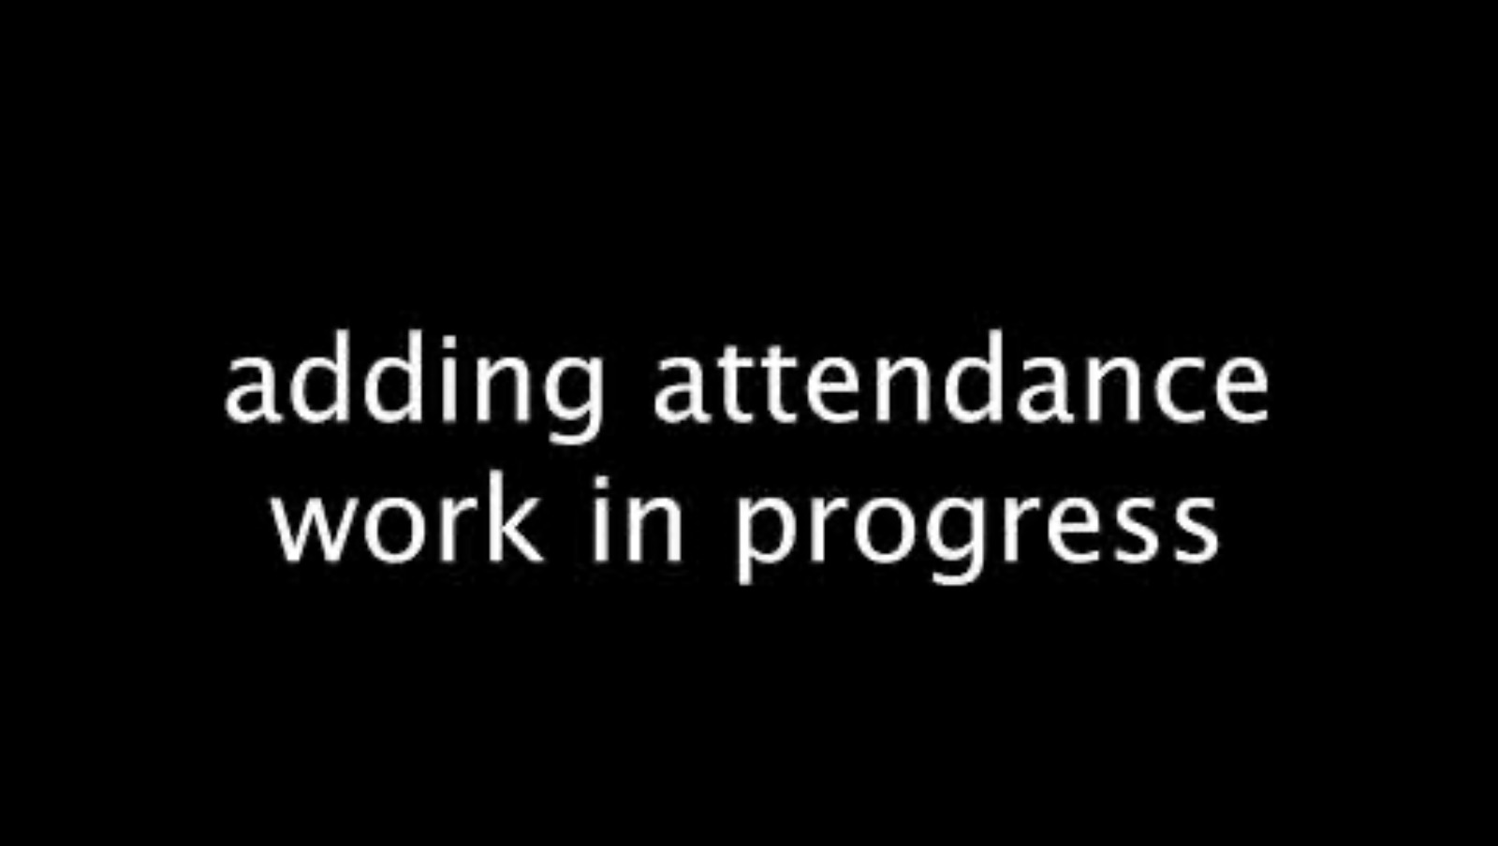
Demo

Slide 10
Future Plans
Complete pending features (attendance, reporting tools).
Improve user interface design.
Conduct additional testing.
Prepare for final deployment.

Slide 11
Conclusion
I will continue to work on this project.

